Slide 1

DECODING THE
2026 TAMIL NADU
ASSEMBLY ELECTION
A fact-based data analysis for AtliQ Media · 234 constituencies · ECI data only
01 THE FLIP STORY
02 THE VOTE SHARE STORY
03 THE MARGIN STORY
Non-partisan analysis · Public ECI data only · Codebasics Resume Project Challenge
Notes:
1

Slide 2
THE DATA BEHIND THE STORY
Three files. One election. 4,257 rows.
tn_2021_results.csv
4,232 rows · 8 columns
Trivedi Centre for Political Data, Ashoka University
tn_2026_results.csv
4,257 rows · 8 columns
Election Commission of India (results.eci.gov.in)
constituency_master.csv
234 rows — regions, districts, reservation status
ECI constituency master list
All analysis is reproducible in the public GitHub notebook · tn_election_analysis.ipynb
Notes:
2

Slide 3
STORY 01
163 of 234 seats
changed hands.
70% of Tamil Nadu's political map was redrawn in a single election.
163 FLIPPED (70%)
71 HELD
Top flip flows:
65
26
22
15
11
DMK → TVK
AIADMK → TVK
DMK → AIADMK
AIADMK → DMK
INC → TVK
Source: ECI · tn_2021_results.csv & tn_2026_results.csv
Notes:
3

Slide 4
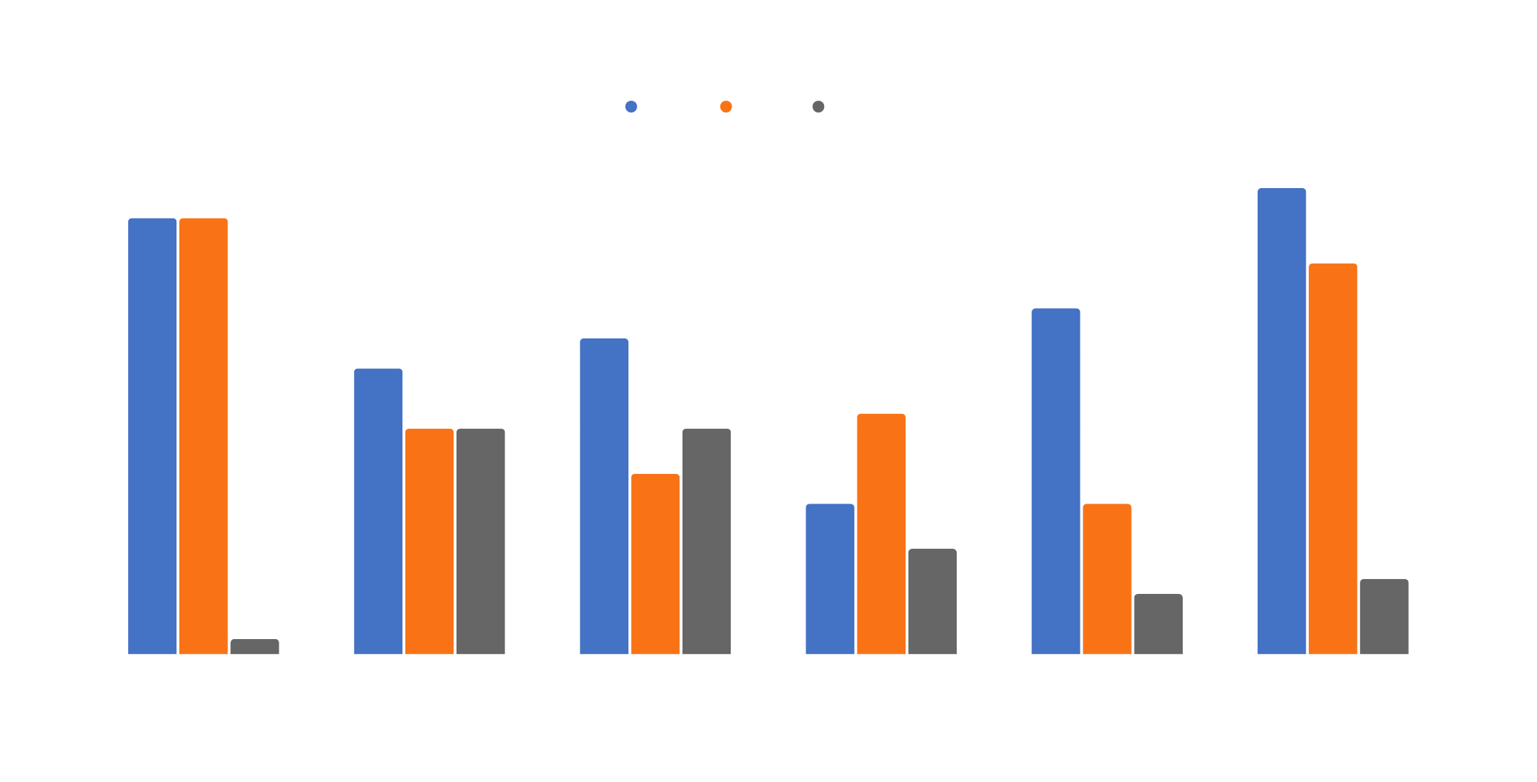
STORY 01 · THE FLIP STORY
Every region flipped. Chennai Metro most completely.
DMK held Chennai Metro, but TVK matched it seat-for-seat · AIADMK resurged in North & Central
Notes:
4

Slide 5
STORY 02
TVK debuted at 34.9% —
ahead of both DMK and AIADMK.
A party that did not exist in 2021 became Tamil Nadu's single largest vote-getter in 2026.
TVK
DMK
AIADMK
Oth
34.9%
24.2%
21.2%
9.3%
2021 vote share for reference:
DMK 37.7%
AIADMK 33.3%
NTK 6.6%
Oth 18.1%
DMK lost 13.5 points · AIADMK lost 12.1 points · The votes moved — overwhelmingly — to TVK
Source: ECI · All-constituency vote totals
Notes:
5

Slide 6
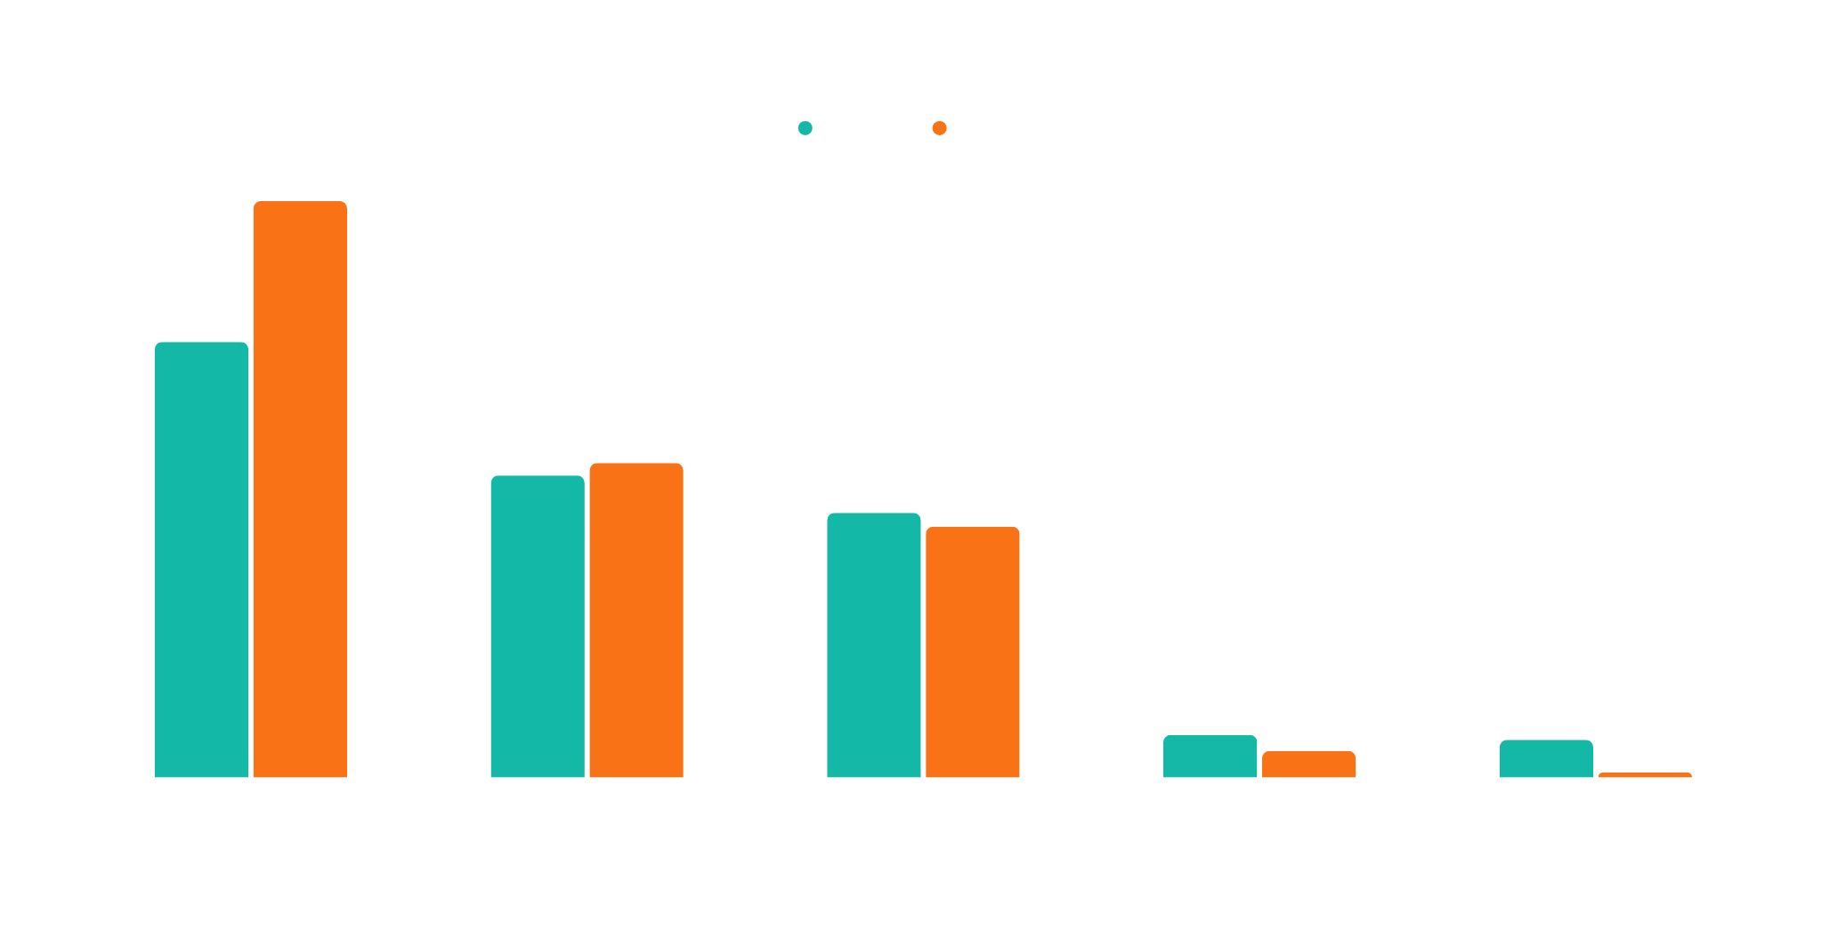
STORY 02 · THE VOTE SHARE STORY
More votes, but seat share tells a different tale.
TVK's vote-to-seat conversion was highest — 34.9% of votes → 46.2% of seats
Notes:
6

Slide 7
STORY 03
Winning got harder.
Average margin fell 27%.
22,871
16,784
−26.6%
Avg winning margin
2021
Avg winning margin
2026
Change in
avg margin
64 seats
13 seats
Winner got < 35% of valid votes
(multi-cornered contests)
Winner got > 50% of valid votes
(dominant wins)
Source: ECI · Constituency-level vote totals
Notes:
7

Slide 8

STORY 03 · THE MARGIN STORY
A three-party race compressed margins everywhere.
In 64 of 234 seats, the winner crossed the line with less than 35% of the vote — a sign of how much TVK split existing coalitions.
Notes:
8

Slide 9
EDITORIAL RECOMMENDATION
For AtliQ Media: structure
the show around three acts.
ACT 1 · The Map Redrawn
Open with the flip visual. 163/234 seats changed hands. It's the biggest hook — a viewer who's lived in TN for 30 years has never seen 70% of the map flip.
ACT 2 · The New Vote Math
Show TVK at 34.9% — higher than DMK in 2021. The split-vote story in 64 seats explains why vote share ≠ seat dominance.
ACT 3 · The Closer Contest
End with the margin story. Margins fell 27%. This election was mathematically tighter than 2021 despite appearing decisive on the seat count.
Notes:
9

Slide 10
HONESTY ABOUT LIMITATIONS
What this data can — and cannot — tell you.
✓ Data CAN answer
✗ Data CANNOT answer
Count seats won and lost by party, 2021 vs 2026
Measure vote share and its change at state and region level
Calculate winning margins and how they shifted
Identify which constituency categories (SC/ST/GEN) moved differently
Explain why any party won or lost (causal claims require survey data)
Attribute vote movement to specific demographic groups
Predict future elections from this data alone
Verify 2026 turnout figures (intentionally excluded from dataset)
Non-partisan analysis · No leaders, symbols, or opinions · Codebasics Resume Project Challenge · Public ECI data only
Notes:
10

